Slide 1

Paried Speaking Test

Slide 2

Part 1:
Short Answer Questions
Tell us something about yourself

Slide 3
Part 2: Mini-presentation
You have 1 min to prepare

Slide 4
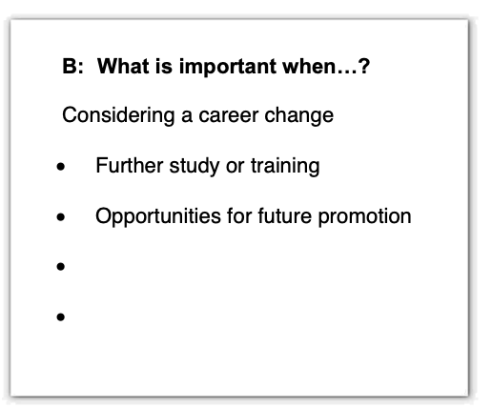
Part 2: Mini-presentation
You have 1 min to prepare

Slide 5
Part 3:
Free discussion

Slide 6
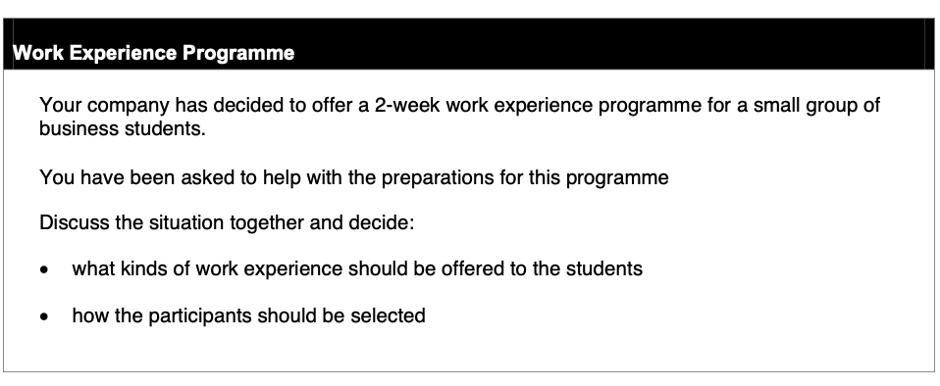
Part 3: Free discussion

